Slide 1
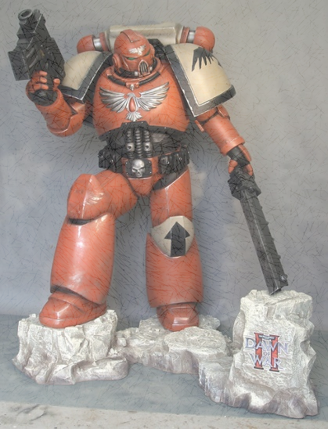
The Restless Bolters Assessment 2 – Team Project Report
TEAM MEMBERS
Bruce Manirath s3805194@student.rmit.edu.au
Jaryd Cavanagh JCav27@outlook.com
Jennelle Roberts s3788427@student.rmit.edu.au
Jack Marsden s3803381@student.rmit.edu.au
Kyle Francis s3805196@student.rmit.edu.au
Github PAGES Link:
Github Repository: https://github.com/s3805194/Restless-Bolters

Slide 2
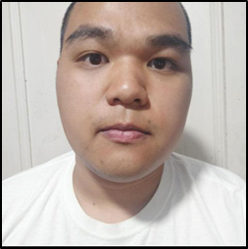
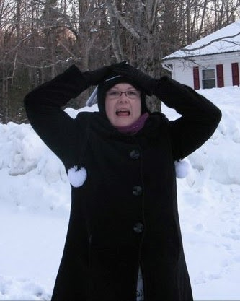
Group Members Profile
Bruce Manirath
Bruce is from Western Sydney and has a goal of getting into software development and is interested in AI and automation.
He is a music buff that loves to play bass guitar and has an affinity for cats. He has an interest about how people and governments are going to adapt to the increased use of AI and automation. Geopolitics is an interest for both Jennelle and Bruce and AI and automation brings up some interesting questions in this perspective. These questions fascinate Bruce and Jennelle.
Questions like, “who owns the data from facial recognition programs?”, “Can facial recognition surveillance contravene the right to privacy?”, “Who sets the ethics that self driving cars use to make decisions?”, “Is there any way to regulate the use of data and police these regulations?”, “How do we protect ourselves from unsavory governments that ignore international conventions on privacy and data collection?”
JENNELLE ROBERTS
Jennelle is also originally from Western Sydney, but now living in Melbourne. The second child of 5, Jennelle is used to noise, differing opinions and nerds. The whole family are nerds made up of scientists, psychologists and IT professionals.
Jennelle has a 9 year old daughter who is autistic. So Jennelle is always up for a chat about diversity advocacy, neurodivergence acceptance and aliens. Aliens are a big topic at the Roberts house.
Jennelle loves to make things fit into lists and tables and as she continued through her career, she realised that this way of organising things meant that data was something that came naturally. She currently works as a Data Analyst for a volume residential builder focusing on Material, Procurement and Costing Data.

Slide 3
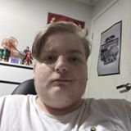
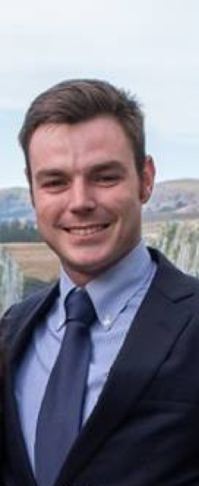
Group Members Profile
Jaryd Cavanagh
Jaryd is a born and bred Melbournian. He lives in Mill Park and has a brother and sister, 2 dogs and a cat.
Jaryd loves computer games and metal music, his favourite type of game being Action Single Player games and his favourite band is Powerwolf, a German power metal band.
Jaryd is excited about IT and would love to be a Web Developer. Providing client specific solutions with a creative difference.
If you want to talk about Game Of Thrones, Jaryd is your man.
Jack Marsden
Jack was born in Tasmania but has also lived in Mount Gambier and Melbourne. Jack joined the Army in 2012 and was assigned to the Royal Australian Signal Corps before commencing training in radio communication systems. Jack currently lives in Brisbane with his Alaskan Malamute, Odin.
Jack has previously been deployed to Afghanistan and currently leads a team that provides telecommunications services via secure voice and data networks. Jack has always had an IT interest since being introduced to IT at school. The thing that appeals to him the most is the potential and possibilities that can be achieved with IT. The ability to communicate, connect, access entertainment and move money around the world. All in seconds! Jack’s current interest in IT is mainly server management focused. He hopes to begin formal training on this aspect of IT soon.

Slide 4
Group Members Profile
Kyle Francis
Kyle was born and bred in Brisbane. He is in fact, still there. Kyle grew up in a family that loved to be on the cutting edge of technology. So IT was a second nature for him that saw him develop a love of computer games and hardware. He would love to be involved in troubleshooting and repair as well as the development of application software.
Kyle’s other loves is for all the cats. We are pretty sure that Kyle has never met a cat he doesn’t love. He has his own cat Braum who is named after a League of Legends character. Braum (The heart of the Freljord) has a wicked moustache, and some of his abilities are to propel freezing ice from his shield as well as become Un-Breakable. All good qualities for a cat.
Kyle has also represented Australia, not once, but twice, at the NASA hosted Space Settlement Design Competition. He is still not sure if he is going to Mars after the initial 2030 mission.

Slide 5
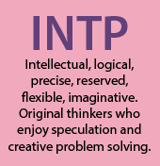
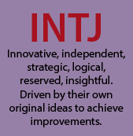
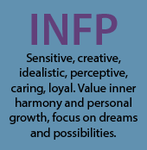
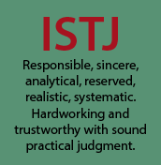
TEAM Myers Briggs TEST RESULTS
Bruce INTP (Introversion, Intuition, Thinking, Perceiving)
Jennelle ISTJ (Introversion, Sensing, Thinking, Judgment)
Jaryd INFP (Introversion, Intuition, Feeling, Perceiving)
Jack INTJ (Introversion, Intuition, Thinking, Judgment)
Kyle LINKS NOT WORKING
Images Source: http://www.maoxian.com/thoughts/myers-briggs-personality-types-matrix

Slide 6
Other personal testing
BRUCE
Bruce completed was The Vark Questionnaire and the Big Five Personality Test
The VARK assessed Bruce as a Mild read/write learning type. People with this Vark Assessment prefer to write and read, use lists, extract meanings from headings and titles and like to have clarity in what is written.
The Big Five Personality test result was that Bruce’s personality was about Openness, Conscientiousness, Extraversion, Agreeableness, Neuroticism
JENNELLE
Jennelle completed Learning Style Test and a Verbal Reasoning Test.
The Learning Style test assessed Jennelle as 60% Auditory, 30% Visual and 10% tactile. This indicates that Jennelle learns by listening and store information the way that it sounds.
The Verbal Reasoning Test result for Jennelle was a high result of 8 out of 10. This indicates the ability to quickly go through presented verbal data, identify the issues and reach logical conclusions
JARYD
Jaryd completed a Learning Style and an IQ test.
The learning style test assessed Jaryd as a Tactile learner
The IQ test gave Jaryd an IQ score between 105 - 120
JACK
Jack completed a Learning Style Test and the Big Five Personality Test.
The Learning Style Test assessed Jack as 62% Visual, 59% Kinesthetic and 46% Auditory
This indicates that Jack learns by seeing (Visual) and doing (Kinesthetic)
The Big Fiver Personality test result was that Jack’s personality was about Conventional, Conscientiousness, Extraversion, Criticalness, Neuroticism
KYLE
Kyle is currently devoid of personality

Slide 7
PERSONALITY TESTING Assessment
The Myers Briggs results seem to indicate that the Restless Bolters are a collection of Introverts.
We do not like to be front facing and often prefer quiet reflection and privacy.
We process ideas and concepts thoroughly by ourselves before taking it out to be used/evaluated by someone else.
We are also Thinkers that prefer objective truths and a process of elimination to determine outcomes.
Where we differ is between Sensing/Intuition and Judgement/Perceiving.
Sensing people need concrete and tangible ideas and deal with the current presented situation, whereas Intuition people place an emphasis on meaning and associations and are very good at spotting patterns.
Judgement people are structured and postulate theories about the world, always willing to try new information in their structured understanding. Whereas Perceiving people are more unstructured and like to keep their options open. But this also means that they are more open to change as they do not have an existing structure.
The collection of other testing the team members went through so that we all come from a different perspective, and learn and create differently.
Having these differences means that we have some diversity in the team. Not everyone will have the same opinion or idea. However all our personality testing shows that we reason and process well, so whilst we might be coming from differing ideas, we all seem to possess the skill to manage that and come up with a concise plan the reflects all our abilities.

Slide 8
IDEAL JOBS COMPARISON
From the assessment: Compare everyone’s ideal jobs. What common elements are there, if any? What differentiates each position from the others, if anything? How similar or different are your career plans across the group?

Slide 9
INDUSTRY DATA
From the assessment: What are the Job Titles for your group's ideal jobs? How do each of these rank in terms of demand from employers?
Ideal jobs skill set:
How do the IT-specific skills in your required skill set rank in terms of demand from employers?
o How do the general skills in your required skill set rank in terms of demand from employers?
o What are the three highest ranked IT-specific skills which are not in your required skill set?
o What are the three highest ranked general skills which are not in your required skill set?
ALL TEAM MEMBERS to personally answer; Having looked at the Burning Glass data, has your opinion of your ideal job changed? Why or why not?

Slide 10
INTERVIEW OF AN IT PROFESSIONAL
Everyone in IT likes to Distill Order from Chaos, Simplicity from Complexity – Allen Roberts (International Director of IT)
Jennelle conducted an Interview with the Biggest IT Nerd she knows – Allen Roberts.
Allen has recently retired after 40+ years working in the IT Industry.
His job prior to retirement was the International Director of IT for a multi-billion dollar American Manufacturing Company.

Slide 11
IT TECHNologies
REPORT ON 4 TECHNOLOGIES
What does it do? (600 words) What is the state of the art of this new technology? What can be done now? What is likely to be able to do be done soon (say in the next 3 years)? What technological or other developments make this possible?
What is the likely impact? (300 words) What is the potential impact of this development? What is likely to change? Which people will be most affected and how? Will this create, replace or make redundant any current jobs or technologies?
How will this affect you? (300 words) In your daily life, how will this affect you? What will be different for you? How might this affect members of your family or your friends?

Slide 12
PROJECT IDEA

Slide 13
FEEDBACK
SPARKPLUS
Towards the end of the assignment period, you should reflect as a group on how well you think you have performed in this assignment. You should include whatever evidence you may have about the groups processes (such as commit trails from GitHub, or project meeting minutes). Each member of the group should contribute up to 200 words about their own perception of the group, and the group as a whole should contribute around 400 words. This should include the following attributes.
• What went well
• What could be improved
• At least one thing that was surprising
• At least one thing that you have learned about groups
• Remember to include in your section on Tools how well you think your Github log of activity reflects your group’s work on this assignment.

